Slide 1
Lecture Management System
E-Learning application

Slide 2
Presented by
Name – SURAJ KUMAR
Roll- 21MCA008
Minor-Project

Slide 3
Special Thanks to:
Guide – Dr. Sharmishta Roy
Co Guide – Mr. Mohan Prakash

Slide 4
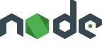


Technology used in this project
Node js /express
React -js
javascript
This technology is used in backend for handling file and streaming video
For handling front-end and for making the user interactive
For manipulation of DOM {DATA OBJECT MODEL}

Slide 5
Features of the application
We can do live streaming through it.
We can share video or lecture of class
We can post article or blog
We can do live chat during live streaming
We can do recording during live stream and store it to database

Slide 6
Why this Software Project ?
There are many streaming app is available on internet, but there is no security assurance and some of them are paid.
The main purpose of this software is to used in e-learning platform where we can take class online and share notes with articles.
Other benefit of this application are listed below
For that I had made it this software project which is totally free.
It assure the security of streaming and with glitch free.
It is user friendly because of no complex model.
We can store video as well as blog

Slide 7
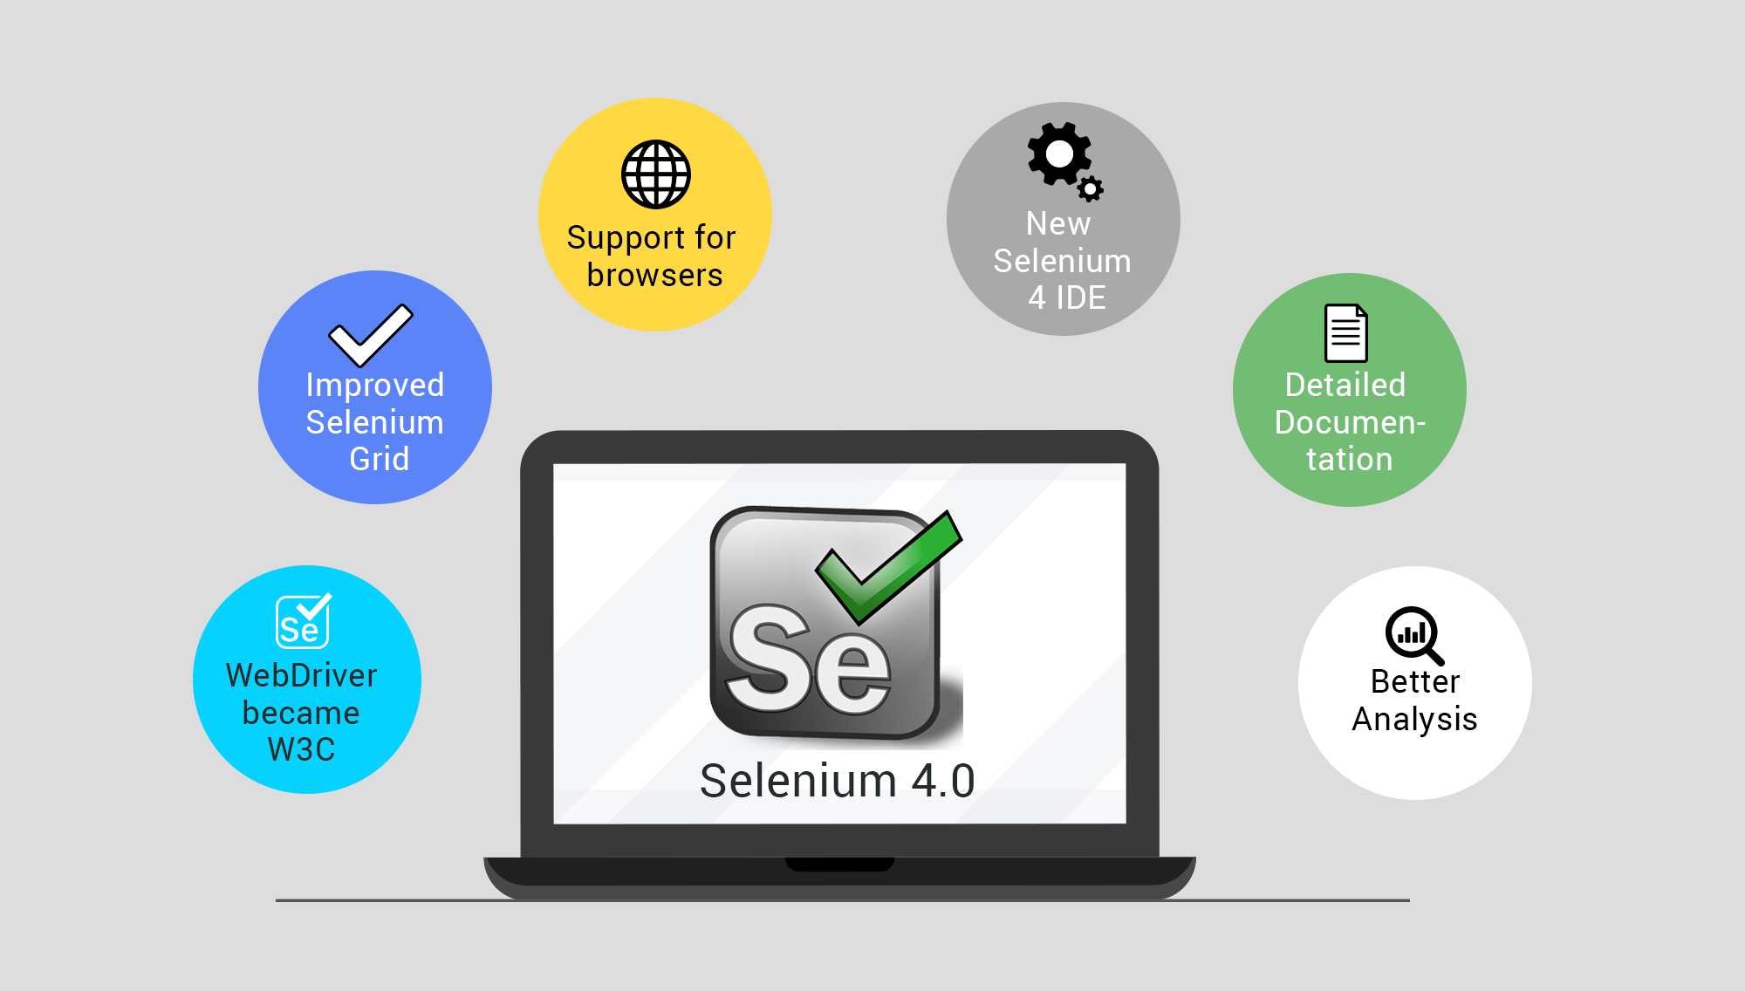
Testing software “Selenium”
Selenium is one of the most widely used open source Web UI (User Interface) automation
testing suite. It was originally developed by Jason Huggins in 2004 as an internal tool at
Thought Works. Selenium supports automation across different browsers, platforms and
programming languages

Slide 8
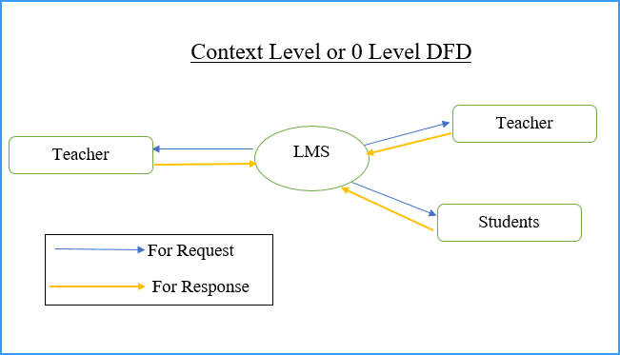

Slide 9
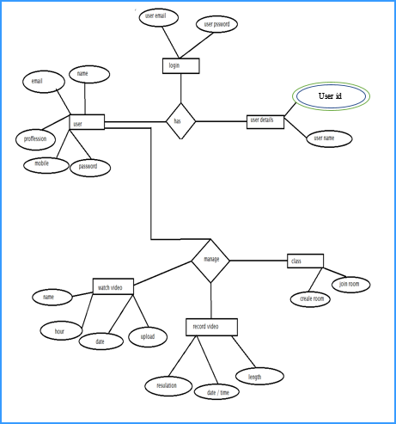
E R Diagram of application

Slide 10
Thank you for giving me an opportunity.

